Slide 1
Deep Draft Navigation Module 2011 Planning Associates Class
Mission Overview Significance, Federal Interest, Policies
Jeremy LaDart
Office of Water Project Review
HQUSACE

Slide 2
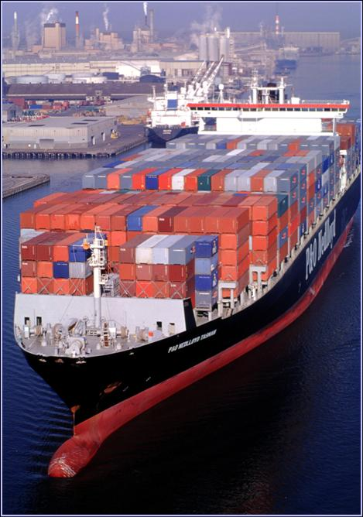
Presentation Outline
Mission Overview
Federal Interest
Policy Guidance
Notes:
EC 1105-2-410 expanded the applicability beyond what was presented in EC 1105-2-408 (per WRDA 2007, Sec 2034). Besides feasibility studies, it also applies to reevaluation studies and reports associated with modification of projects that include an EIS; any other reports or project studies requiring a Chiefs Report, authorization by Congress, or an EIS. CAP is currently excluded unless an EIS is required.

Slide 3
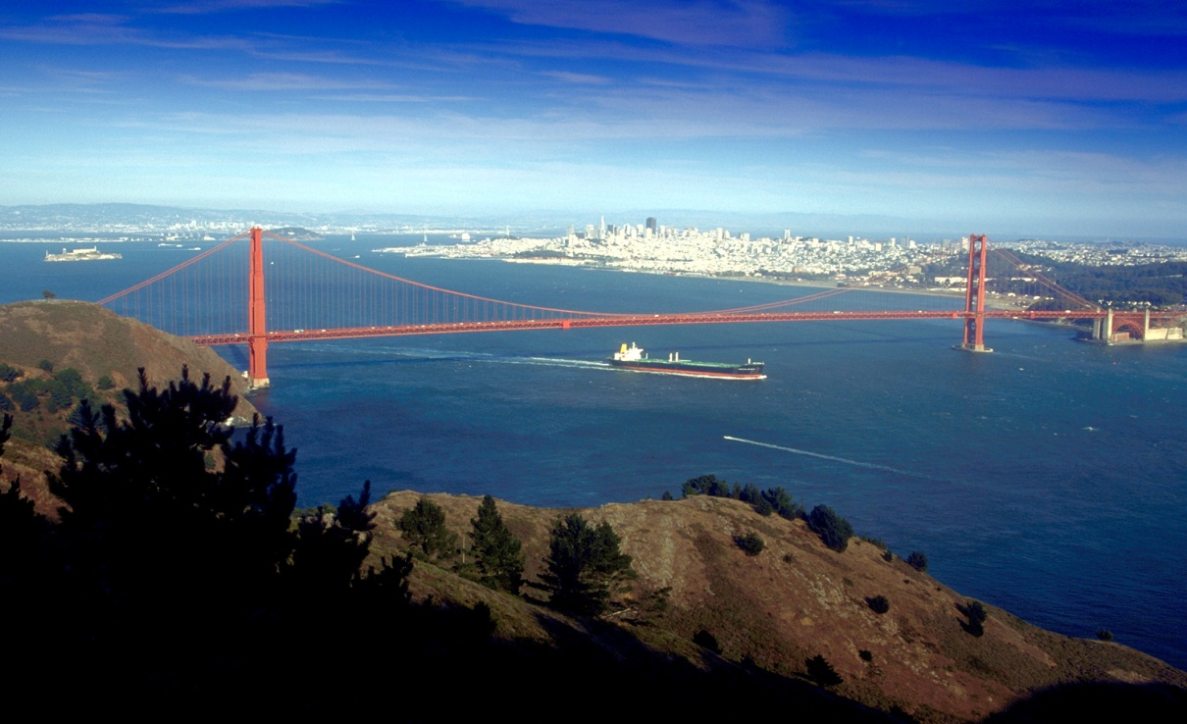
Federal Involvement
The Federal Interest in Navigation is established by the Commerce Clause of the U.S. Constitution.
Navigation provides an efficient means of commercial transportation,
and contributes to the national defense.
Notes:
EC 1105-2-410 expanded the applicability beyond what was presented in EC 1105-2-408 (per WRDA 2007, Sec 2034). Besides feasibility studies, it also applies to reevaluation studies and reports associated with modification of projects that include an EIS; any other reports or project studies requiring a Chiefs Report, authorization by Congress, or an EIS. CAP is currently excluded unless an EIS is required.

Slide 4
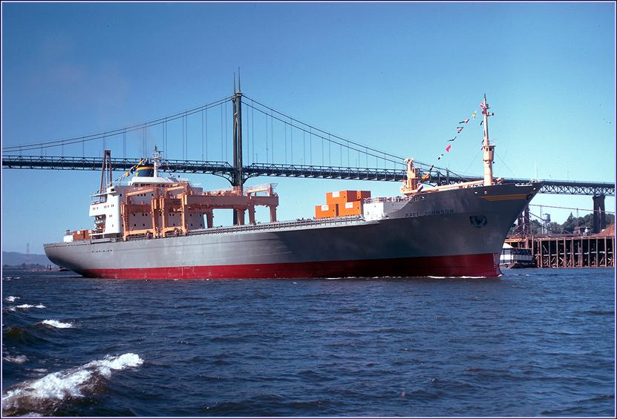
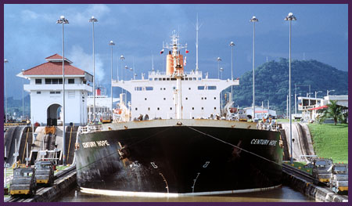
The Corps’ Navigation Mission
Provide safe, reliable, efficient, effective and environmentally sustainable waterborne transportation systems for movement of commerce, national security needs, and recreation.
Notes:
USACE policy is that all technical, engineering, and scientific work will undergo an open, dynamic and vigorous review process.

Slide 5
The Corps’ Navigation Mission
Federal interest in navigation is established by the Commerce Clause of the Constitution…
and, subsequent court decisions defining the right of the Federal Government to regulate navigation and improve navigable waterways.
In 1824 Congress designated the U.S. Army Corps of Engineers as the Federal agency responsible for the Nation's navigation system.
“Deep Draft” is generally defined as project depths greater than 14 feet.

Slide 6
Federal Interest / Significance
Nationally, the Corps is responsible for maintenance of about 300 deep-draft port and harbor projects.
These ports and harbors handle nearly 2.6 billion tons of domestic and foreign cargo annually, which is about 90% of U.S. maritime trade.
U.S. ports and harbors support more than 13 million jobs nationwide.
Notes:
- RP’s are stand alone because we must have them individually posted to satisfy the Information Quality Act, and they must be available to the public for comment.
-RPs must be detailed enough to assess the necessary level and focus of review (e.g., which parts of the study will likely be challenging, which models and data are proposed, model certification needs, etc). RPs must identify the review requirements, process, cost and schedule as integrated features of the overall project execution. They must define the appropriate level of review based upon an assessment of where project risks are most likely to occur and the magnitude of what this risk might be. They must also address how written responses to the Review Report will be handled. The content of RPs is contained in paragraph 4, pages B-1 to B-2.
Each RP must have an MSC approval memo signed by the MSC Commander. Upon approval of the RP, a copy of the signed MSC approval memo should be provided to the RIT.
The opportunity to comment is fulfilled by posting the documents and accepting any comments that come in. This is not to be confused with the 45 day comment period of other requirements

Slide 7
U.S. Harbors Handling over 10 Million Metric Tons
Anacortes
Seattle
Tacoma
Portland
Two Harbors
Duluth/Superior
Portland
Boston
Detroit
Chicago
New York/NJ
Richmond
Indiana Harbor
Cleveland
Lower Delaware
River
Oakland
Baltimore
Newport News
Norfolk
Los Angeles
Long Beach
Million
Metric Tons
Charleston
Over 100
Baton Rouge
Savannah
Lake Charles
Pascagoula
Jacksonville
50 - 100
Houston
Mobile
Valdez
Honolulu
Texas City
Plaquemines
Tampa
25 - 50
Freeport
Port Arthur
New Orleans
10 - 25
Beaumont
Corpus Christi
S. Louisiana
Port Everglades
Notes:
Distinguished by who manages the review – discuss details on following slides, not here

Slide 8
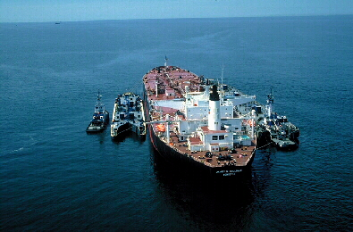
The Corps’ Navigation Mission
The navigation mission is the largest component of the Corps Civil Works program.
The annual navigation budget for planning, engineering, construction, and operations and maintenance exceeds $1.7 billion (FY 2010).
~21 percent is for new construction, ~79 percent is for O&M (FY 2010).
Notes:
The PDT is responsible for a complete reading of the report to assure the overall integrity of the report, technical appendices, and the recommendations before approval by the District Commander.
Quality decision documents allow the reader to understand the planning process, and enable decision makers to reach the same conclusions as the reporting officers.

Slide 9
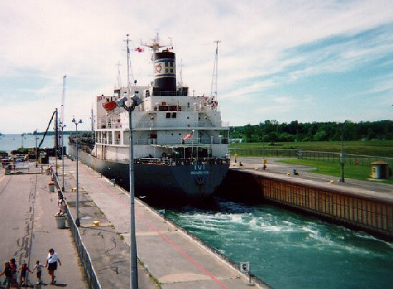
What is the Deep Draft Navigation System?
Channels – Provide depth & width
Jetties & Breakwaters - Protect against waves & shoaling
Anchorages & Turning Basins
Local Service Facilities
Dredged Material Disposal Sites
Locks – Exception rather than rule for Deep-Draft Navigation
Notes:
AS A MINIMUM:
ATR will examine the FSM and AFB submittal materials, draft and final decision documents, supporting documents, and other supporting analyses. Interim ATR should also occur for any key technical products.
Each application of ATR should build upon prior cycles of review for the study – focus in the incremental changes and additions to the products.

Slide 10
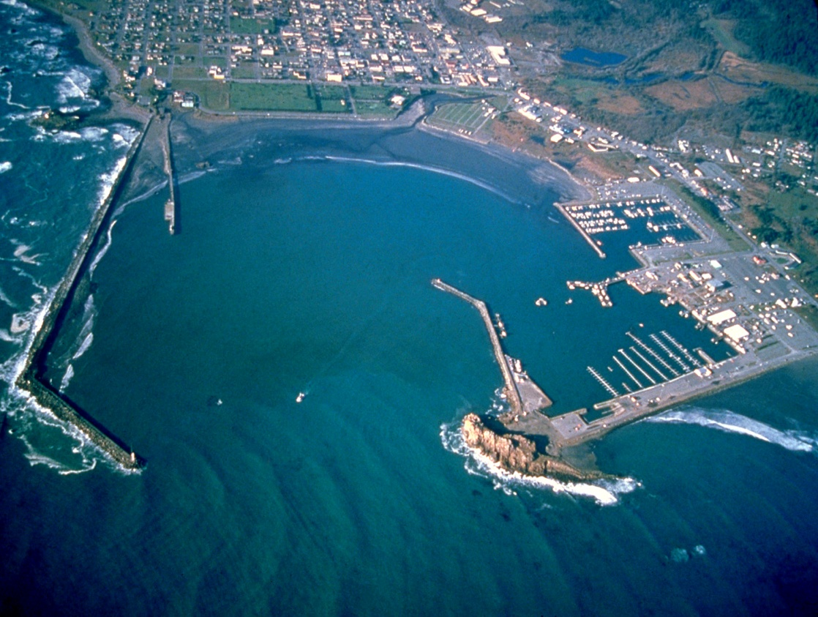
Federal Responsibilities
General Navigation Features (GNF)
Channels
Jetties
Anchorages
Breakwaters
Locks
Disposal Sites (since WRDA 96)
Aids to Navigation
Notes:
AS A MINIMUM:
ATR will examine the FSM and AFB submittal materials, draft and final decision documents, supporting documents, and other supporting analyses. Interim ATR should also occur for any key technical products.
Each application of ATR should build upon prior cycles of review for the study – focus in the incremental changes and additions to the products.

Slide 11
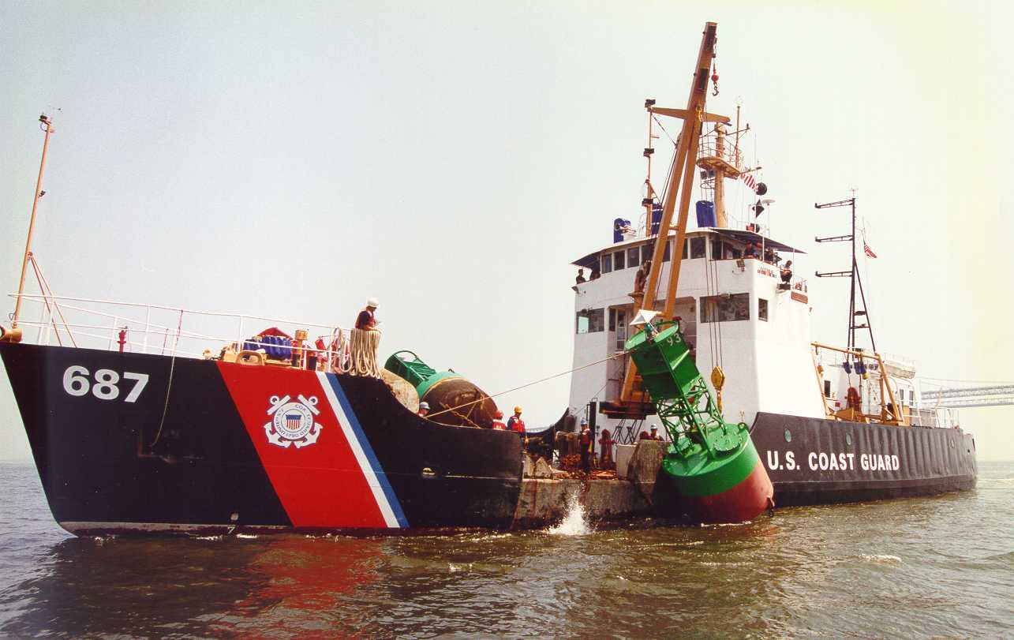
Federal Project Features not Included as Corps Responsibility
The U.S. Coast Guard is responsible for Aids to Navigation
Buoys
Lights
Ranges
Other Marks

Slide 12
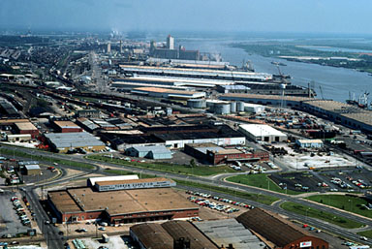
Non-Federal Responsibilities
Cost share in the construction of General Navigation Features
Cost share O&M
Provide LERR
Provide LSF

Slide 13
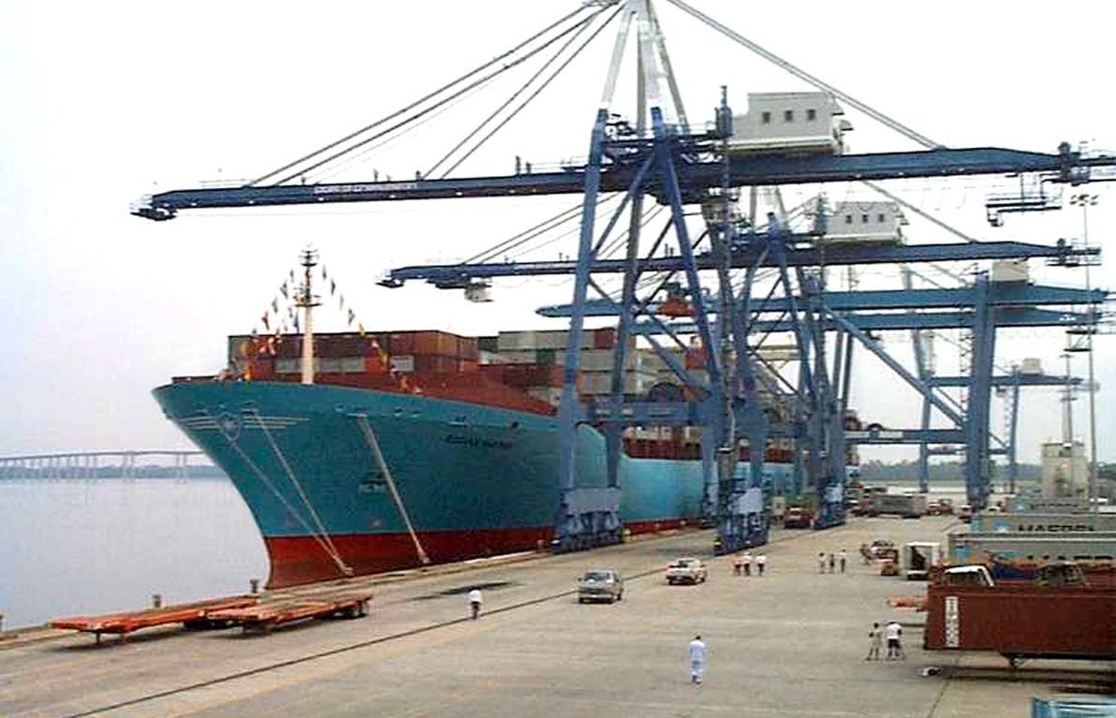
Local Service Facilities
Docks & Berthing Areas
Terminal and transfer facilities
Local access channels
Must be accessible and available to all on equal terms
Notes:
NOTE – Methodology for distributing FY09 funds???????

Slide 14
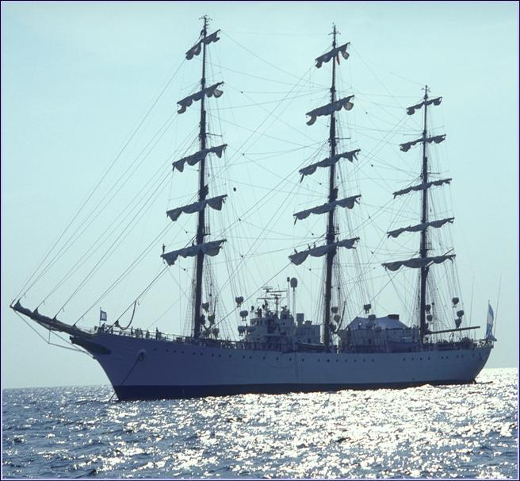
Policy Guidance & Authorities
Notes:
IEPR Waiver:
Determination made by Chief of Engineers
Limited conditions where there is no EIS and
(a) is not controversial
(b) negligible adverse impacts on scarce or unique cultural, historic, or tribal resources
(c)has no substantial adverse impacts on fish and wildlife species and their habitat
(d)negligible adverse impacts on Endangered Species
The Chief may also exclude a project study if:
Involves only the rehabilitation or replacement of existing hydropower turbines, lock structures, or flood control gates, within the same purpose as an existing water resources project;
(a) is for an activity for which there is ample experience within USACE of Engineers and industry to treat the activity as routine
(b) has minimal life safety
(c) CAP study without an EIS.
Review 8 criteria in Appendix D – Waiver only required if a criterion is met for IEPR and the PDT/MSC decides not to implement.
Waiver Process:
PDT determine if an IEPR trigger is met and reasons for not conducting.
District prepares Waiver Request
MSC review/endorse Waiver Request to HQ RIT.
RIT coordinate Waiver Request with OWPR and PL CoP.
RIT/OWPR/PL CoP present Waiver Request to Chief of Engineers for decision.

Slide 15
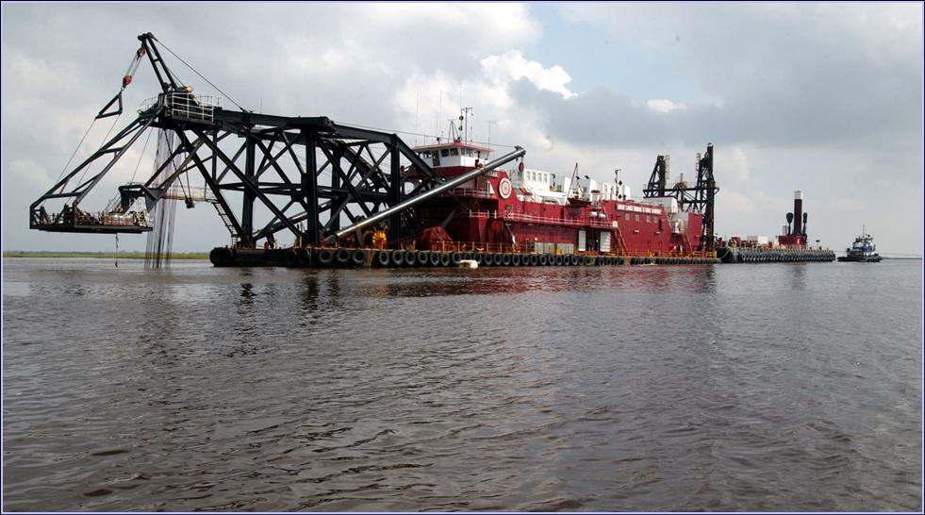
Primary Authority for Deep Draft Navigation Section 101 of WRDA 86

Slide 16
Navigation Policy Guidance http://www.usace.army.mil/cw/cecw-cp/library/planlib.html
Engineering Regulations
ER 1105-2-100, Chapter 3-2
EP 1165-2-1, Policy Digest, Chapter 12
ER 1165-2-131 (Appendix G)
ER 1165-2-120, -122, and -124 relate to non-Federal studies, construction, and reimbursement
ER 1165-2-25 (Bridge Alterations)
Policy Guidance Letters (PGLs)
There are a total of 19 navigation PGLs.
PGLs 44, 47, 49 (superseded), 56 and 62, are perhaps the most useful--all relate to cost sharing.

Slide 17
Policies Affecting Navigation
Beneficial uses of dredged material
Access channels
Single owner policy
Progressive development
Notes:
PDT may conduct a coordination meeting/teleconf to ensure comments are understood so that responses can be prepared. They may also provide initial draft responses for this purpose.

Slide 18
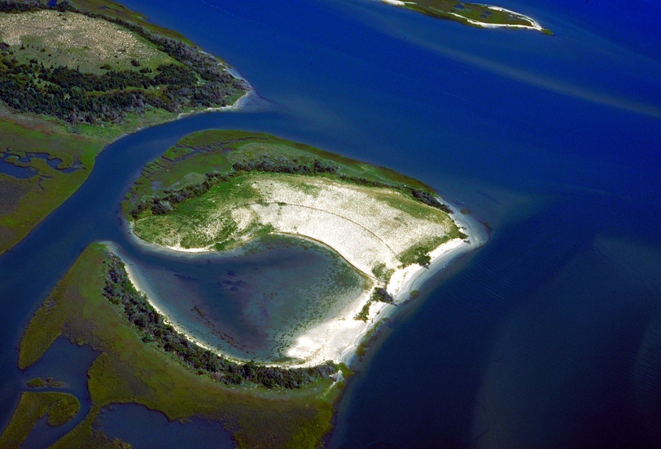
Beneficial Uses of Dredged Material
Land Creation
Beach Nourishment
Mitigation/Restoration

Slide 19
Beneficial Uses - Beach Nourishment
Authorized by Section 204 of WRDA 1992 and Section 207 of WRDA 1996
Eligibility for Federal cost-sharing
The State requests it,
The Secretary of the Army considers it in the public interest,
Hurricane and storm damage benefits will justify the additional expense, and
The beach is open to public use.

Slide 20
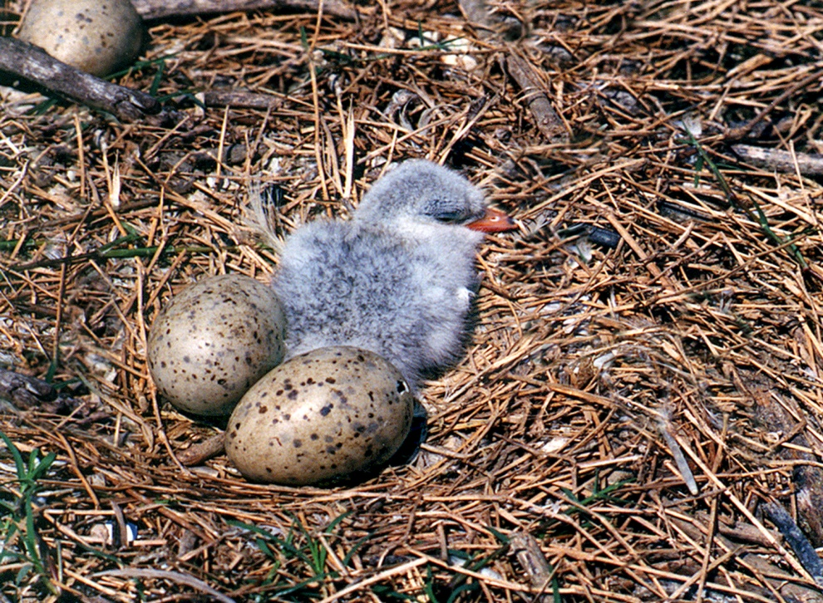
Beneficial Uses - Restoration/Mitigation
Creation of wetlands is most common beneficial use
Creation of shallow water habitat / Islands for nesting
Ecosystem restoration can be accomplished in the context of a multi-purpose project

Slide 21
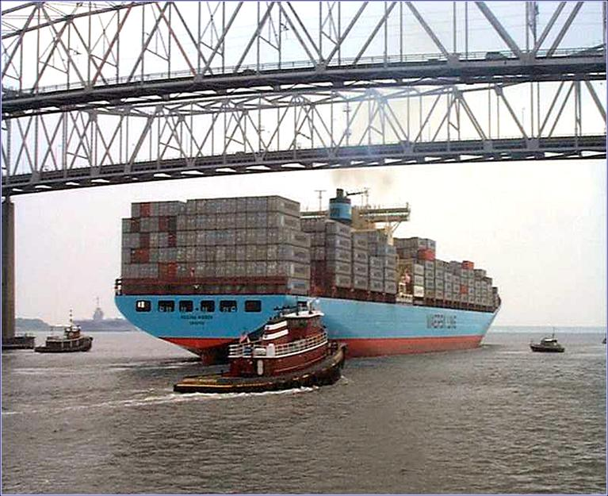
Policies - Access Channels
Number of facilities served must be:
Two or more with separate owners
- or
Under public ownership

Slide 22
Single Owner Situations and General vs. Special Interest Considerations
Determination of general interest is required to apply WRDA ‘86 cost sharing.
Determination of general interest requires consideration of number and type of properties served;
Two or more facilities,
Multiple users of a single facility who have formed a non-profit cooperative,
Or a Public facility.

Slide 23
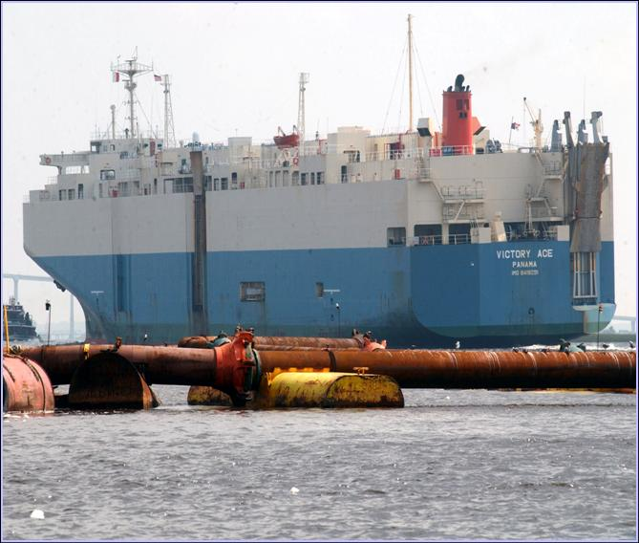
Policies - Progressive Development
Progressive development includes situations where the last small increment of a channel serves a non-public owner.
This is treated as a multiple-owner situation unless a disproportionate incremental investment is required.

Slide 24
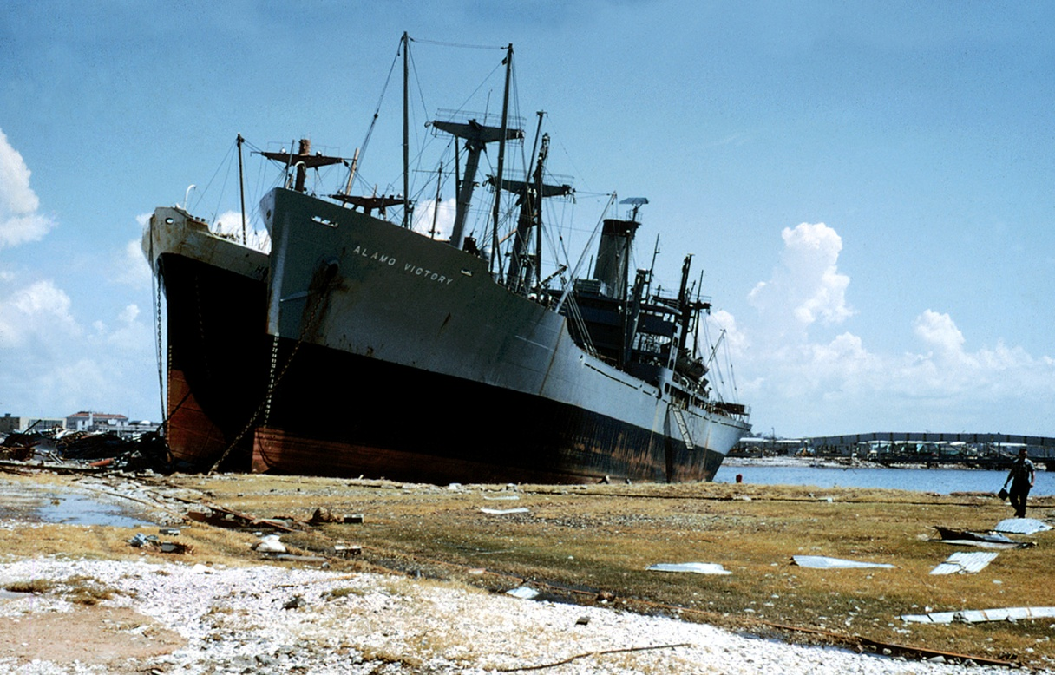
Special Corps Navigation Programs
Removal of wrecks and obstructions
Modification of existing highway and rail bridges that obstruct navigation
Clearing and snagging for navigation
Drift and debris removal
Mitigation of shoreline damage
Dredging contaminated sediments

Slide 25
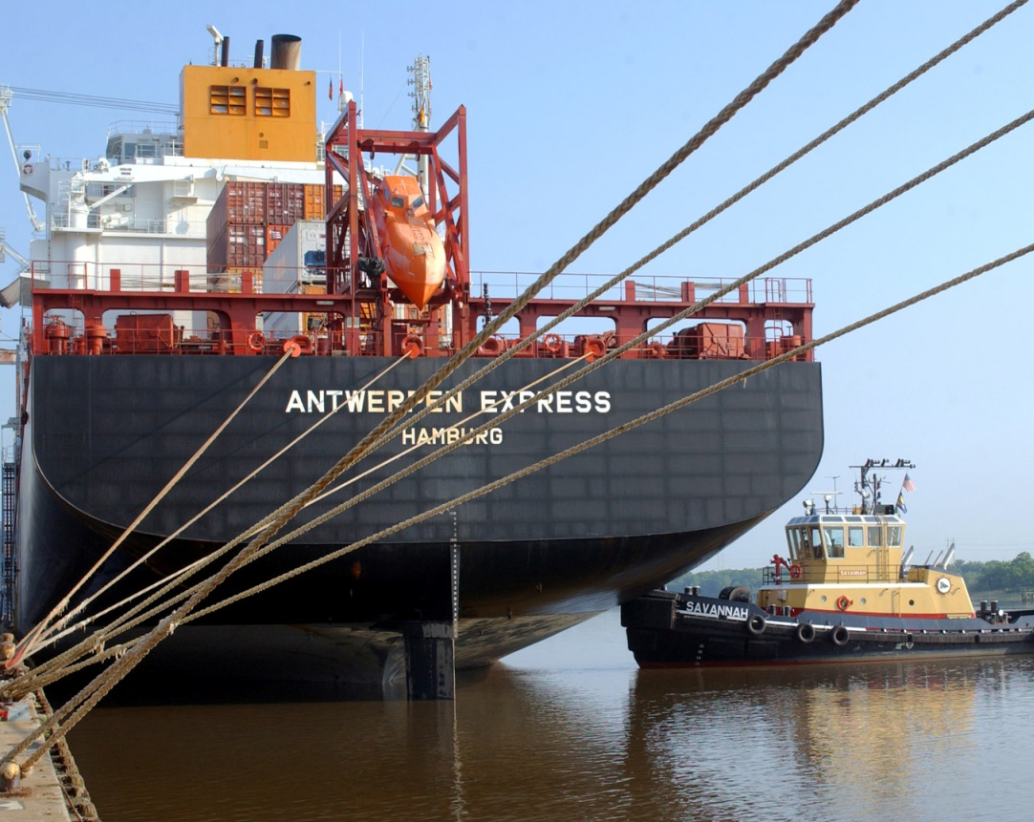
Take Away Points
Navigation is the oldest and largest Corps mission
“Federal Interest” is with the General Navigation Features
Policies Encourage Beneficial Use of Dredged Material

Slide 26
Questions/Discussion

